Slide 1

Title of your Project
Group members with Student Id
Bhumika Nikam-23107009
Sara Rajpurkar-23107096
Rutuja Sawant-23107143
Project Guide
Dr. Veena Trivedi

Slide 2
Outline
Introduction
Literature Survey of the existing systems
Limitations of the existing systems
Problem statement
System Design
Technologies and methodologies
Implementation
Conclusion
References

Slide 3
Sustainable Development Goals (SDG) mapped
SDG 15: Life on Land:
Promotes Biodiversity Awareness – Retrieves and displays flower name, description, origin, and symbolism, helping people understand and value plant diversity.
Strengthens Sustainable Practices – Provides flower care tips such as sunlight, watering, soil type, and suitable weather, guiding eco-friendly plant care and gardening.
Bridges Technology & Nature – Uses AI to suggest visually similar flowers through image-based features, blending digital innovation with biodiversity conservation.
Supports Agriculture & Green Industries – Suggests property-similar flowers based on care needs, climate compatibility, or usage, supporting farmers, florists, and gardeners.
Global Reach – Allows users to give feedback and maintain a flower logbook, enabling global participation in biodiversity knowledge-sharing and conservation.

Slide 4
Introduction
Project Overview
FloralQ is an intelligent system designed to identify , predict flowers and suggest easy and helpful gardening tips for flowers.
It uses AI-driven image recognition to provide accurate and relevant results, overcoming the limitations of existing general-purpose tools.
Real-time Problem Observation :
Difficulty in finding visually similar flowers through existing apps.
Current solutions lack floral-specific accuracy.
Users often get irrelevant or incomplete suggestions

Slide 5
Motivation:
Growing demand for personalized and accurate flower identification.
Increasing use of AI/ML in daily applications inspired us to apply it to floriculture.
Desire to create a specialized system rather than relying on general-purpose tools.
Objectives:
Retrieve and display flower name, description, origin, and symbolism after classification.
Provide flower care tips including sunlight, watering, soil type, and suitable weather. Allow user feedback for better experience.
Suggest visually similar flowers using image-based features.
Suggest property-similar flowers based on care needs, climate compatibility, or usage.

Slide 6
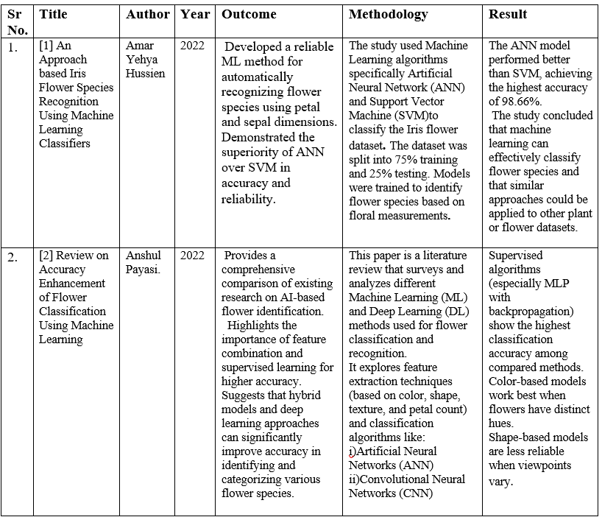
Literature Survey of the existing system

Slide 7
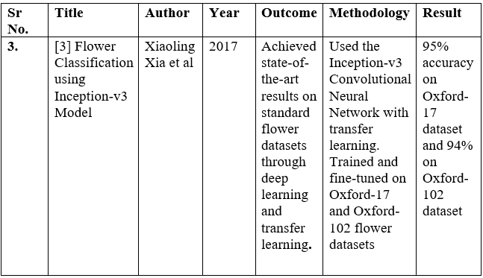
Literature Survey of the existing system

Slide 8
Limitations of existing systems
Our Contribution (FloraIQ)
Custom 40-class dataset for prediction.
Provides description, symbolism, origin, care tips.
Handles unknown flowers with “Not in Database” message.
Interactive GUI with Welcome, Home, Similar Property Flower, Visually Similar Flower, Feedback pages.
GUI for Similar Property & Visually Similar Flower ready; backend integration in progress.

Slide 9
Limitations of existing systems
Limited Dataset Variety
Most existing systems (like the Iris dataset) focus only on a small number of flower species.
They do not represent real-world diversity in color, shape, texture, or regional species.
Dependence on Specific Features
Many models rely on simple geometric features instead of real-world image data.
Lack of Environmental and Contextual Data
Existing systems classify flowers based only on visual data.
No Multimodal or Hybrid Approach
Current research generally focuses on either machine learning (ML) or deep learning (DL) separately.
A hybrid model combining both is rarely implemented.

Slide 10
Problem statement
Problem Statement : Identifying flowers is often difficult due to the vast number of species and their visual similarities. Existing solutions are either time-consuming or lack practical features. FloraIQ aims to solve this by developing an AI-based flower recognition system that provides instant identification along with essential details and care tips.
Description : Users struggle to correctly identify flowers without expert help.Traditional methods (manual guides, books) are slow and inconvenient.Current applications are limited and often lack:Clear flower details (name, description, origin, symbolism).Care guidance (watering, sunlight, soil, climate).
FloraIQ provides a solution through:AI-based flower recognition using MobileNetV2.Simple and interactive HTML-based GUI for easy use.Detailed flower information and care tips.Similar flower suggestions for better knowledge.

Slide 11
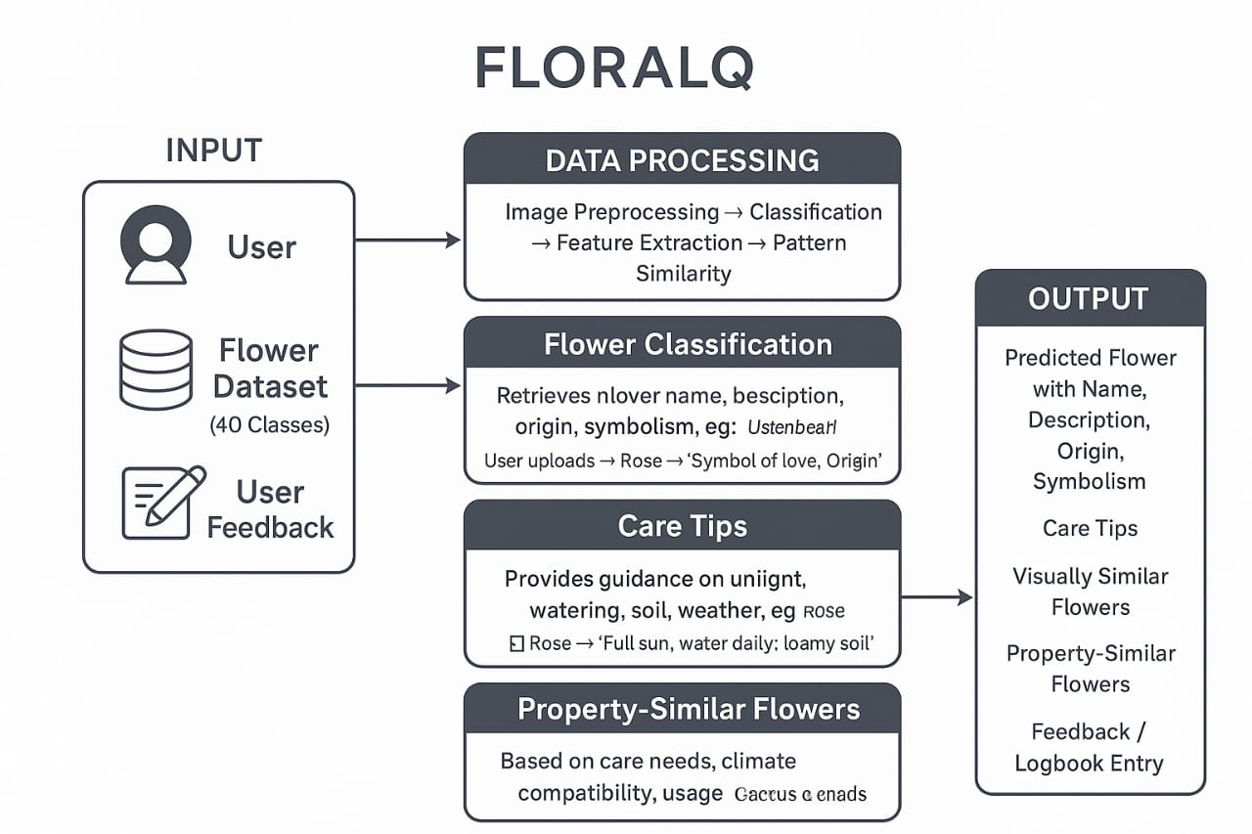
System Design

Slide 12
Technologies and methodologies
Technologies Used in FloralQ IDE & Development Environment:
PyCharm – for coding, debugging, and project management.
Programming Language Python – main language for model development and application logic.
Html for frontend development (GUI).
Dataset Kaggle Flower Dataset – source of labeled images for training and testing.

Slide 13
Technologies and methodologies
Methodology:
Problem Definition Goal: Identify and classify flower species based on images.
Data Collection Flower dataset downloaded from Kaggle.
Model Training Train MobileNetV2 on training set using TensorFlow/Keras.
Model Evaluation Test accuracy, precision.
Deployment Create a UI (Flask) for users to upload an image and get predictions.

Slide 14
Implementation

Slide 15
Conclusion
The FloralQ mini project effectively fulfills its objectives by accurately classifying flowers and displaying essential information such as name, description, origin, and symbolism. It provides comprehensive care tips, including sunlight, watering, soil type, and suitable weather, helping users maintain healthy plants. The system also enhances user experience by suggesting visually similar flowers and property-similar flowers based on care needs and climate compatibility. Additionally, features like user feedback and a flower history logbook make the application interactive and practical. Overall, FloralQ serves as a smart and user-friendly tool for flower identification, care, and exploration.

Slide 16
References
[1] Raunak Kharbanda, Shubham Singhal, Soumi Ghosh, and Dilshad Anjum Khan, “Literature Review on Flower Classification using Machine Learning and Deep Learning,” International Conference on Innovative Computing and Communication (ICICC 2024), SSRN, 2024.URL: https://ssrn.com/abstract=4768206
[2] Anshul Payasi and Srashti Thakur, “Review on Accuracy Enhancement of Flower Classification Using Machine Learning,” International Journal of Scientific Research & Engineering Trends (IJSRET), vol. 11, no. 1, pp. 729–734, Jan-Feb 2025. ISSN: 2395-566X.URL: https://ijsret.com/2025/IJSRET_V11_issue1_202.pdf
[3] S. Bhutada, K. Tejaswi and S. Vineela, “Flower Recognition Using Machine Learning,” International Journal of Researches in Biosciences, Agriculture and Technology, vol. 4, no. 2, pp. 67–73, 2021.
URL: https://www.ijrbat.in/downloads/2021/vol-4/issue-2/Paper%20ID-101.pdf

Slide 17
Thank You...!!

